Slide 1
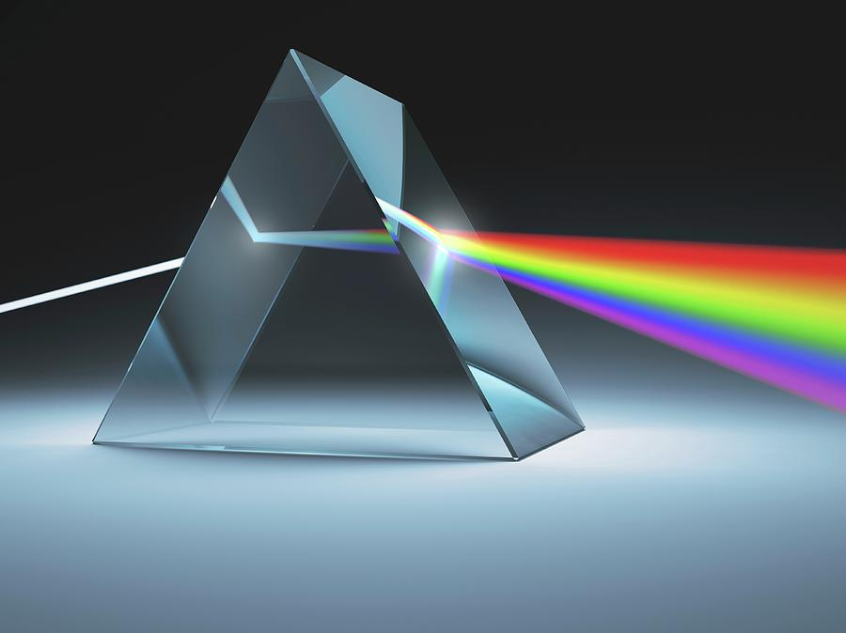
Image formation

Slide 2
References
http://szeliski.org/Book/
http://www.cs.cornell.edu/courses/cs5670/2019sp/lectures/lectures.html
http://www.cs.cmu.edu/~16385/

Slide 3
Contents
BRDF
Pinhole camera
Digital camera
The human eye
Image transformations

Slide 4
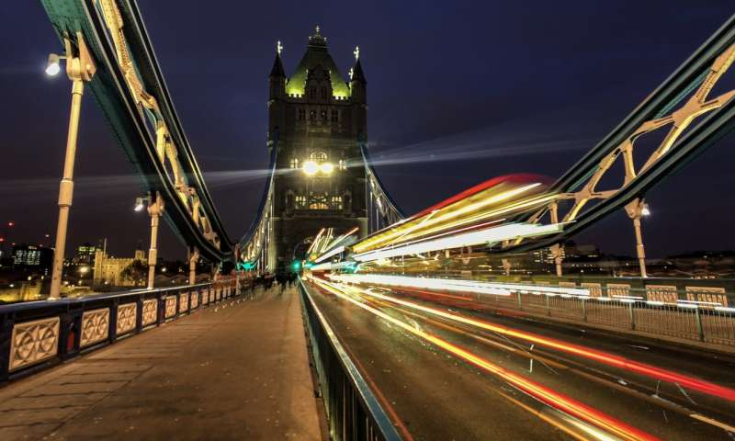
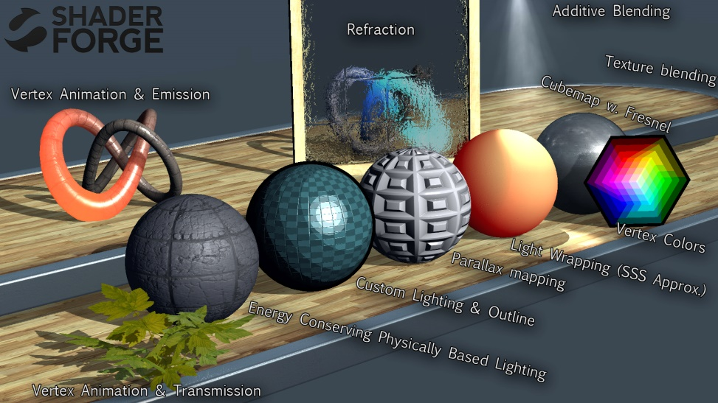
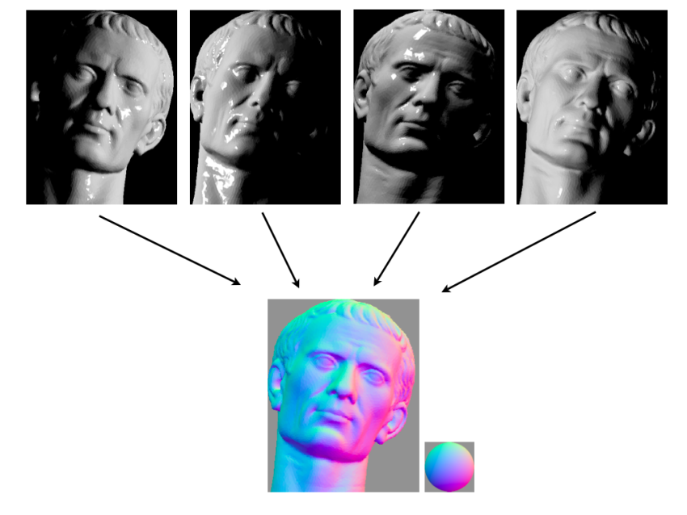

Some motivation
Art
(Exposure time)
3D game rendering
(ray tracing)
Computational photography
(shape from shading- 3D reconstruction)
Computational photography
(aperture blur shape)

Slide 5
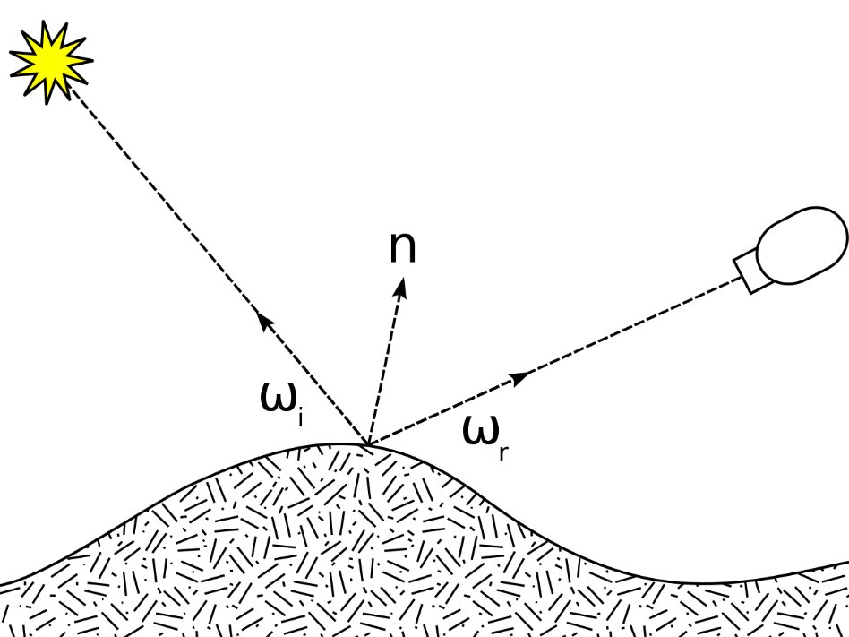
Image formation
Let’s talk about what happens before the image is captured- how it’s captured and why do we see it the way the we see it.

Slide 6
Contents
BRDF
Pinhole camera
Digital camera
The human eye
Image transformations

Slide 7
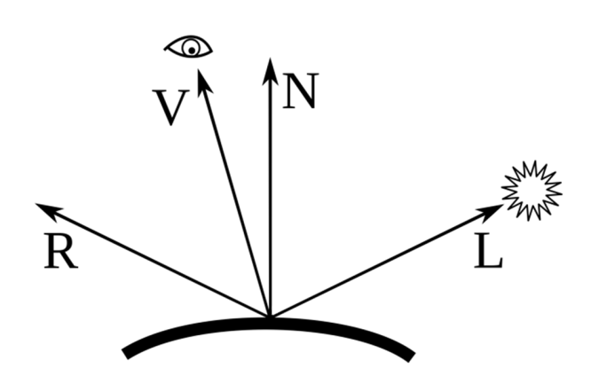
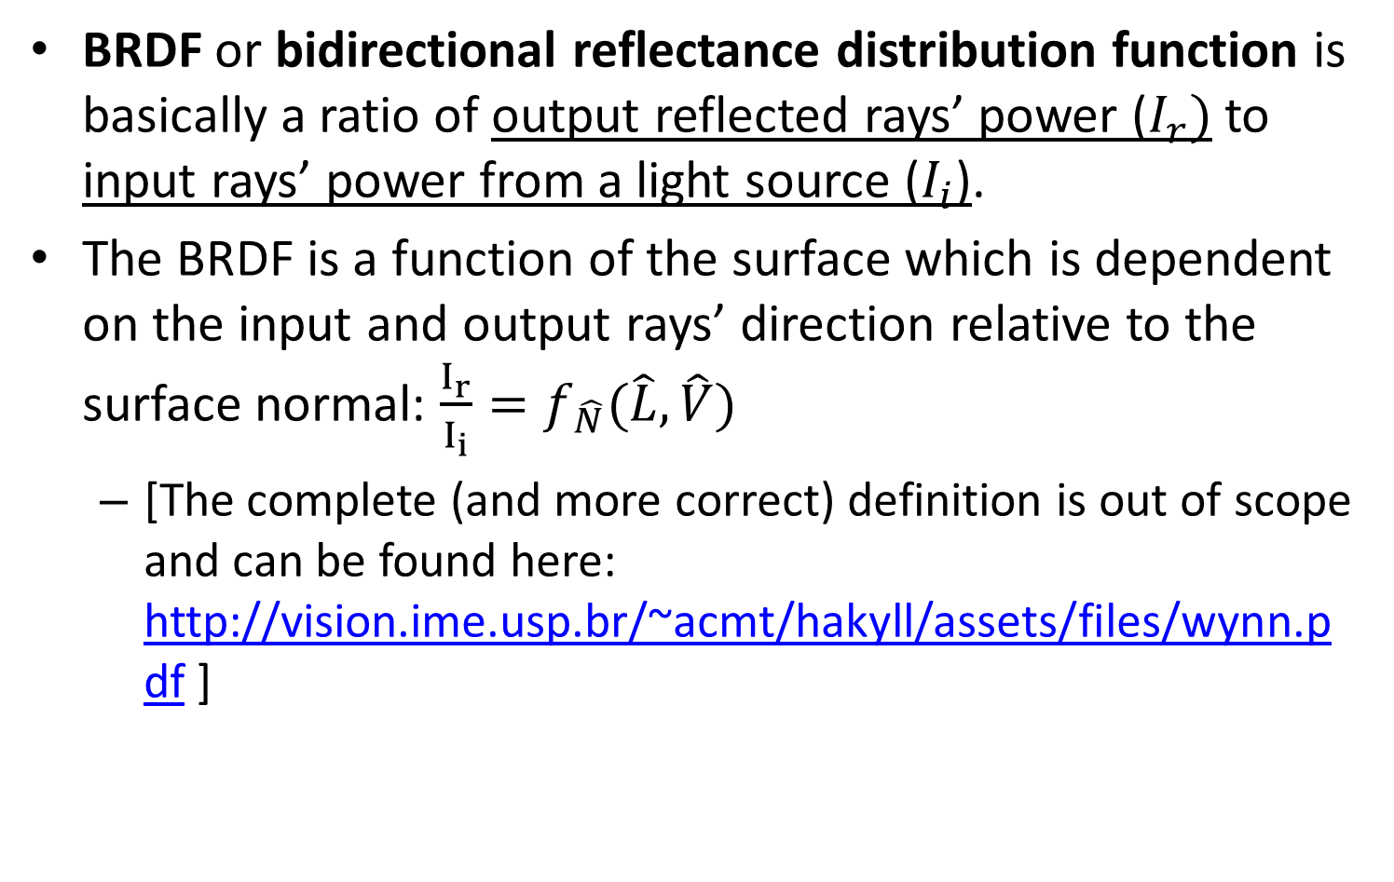
BRDF
BRDF or bidirectional reflectance distribution function is basically a ratio of output reflected rays’ power ($I_{r})$ to input rays’ power from a light source ($I_{i}$).
The BRDF is a function of the surface which is dependent on the input and output rays’ direction relative to the surface normal: $\frac{I_{r}}{I_{i}}=f_{\hat{N}}(\hat{L},\hat{V})$
[The complete (and more correct) definition is out of scope and can be found here: http://vision.ime.usp.br/~acmt/hakyll/assets/files/wynn.pdf ]

Slide 8

BRDF
BRDF is used extensively in photorealistic rendering, but also in 3D reconstruction and image deblurring.
When rendering 3D images with ray tracing, actual rays are generated and propagate through the scene using the BRDF of each material.

Slide 9
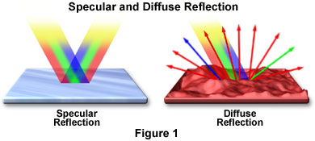
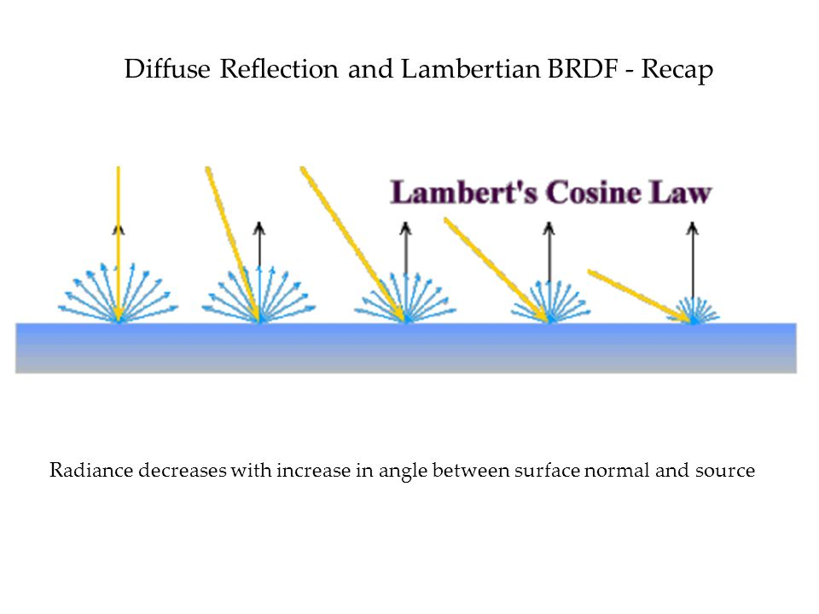
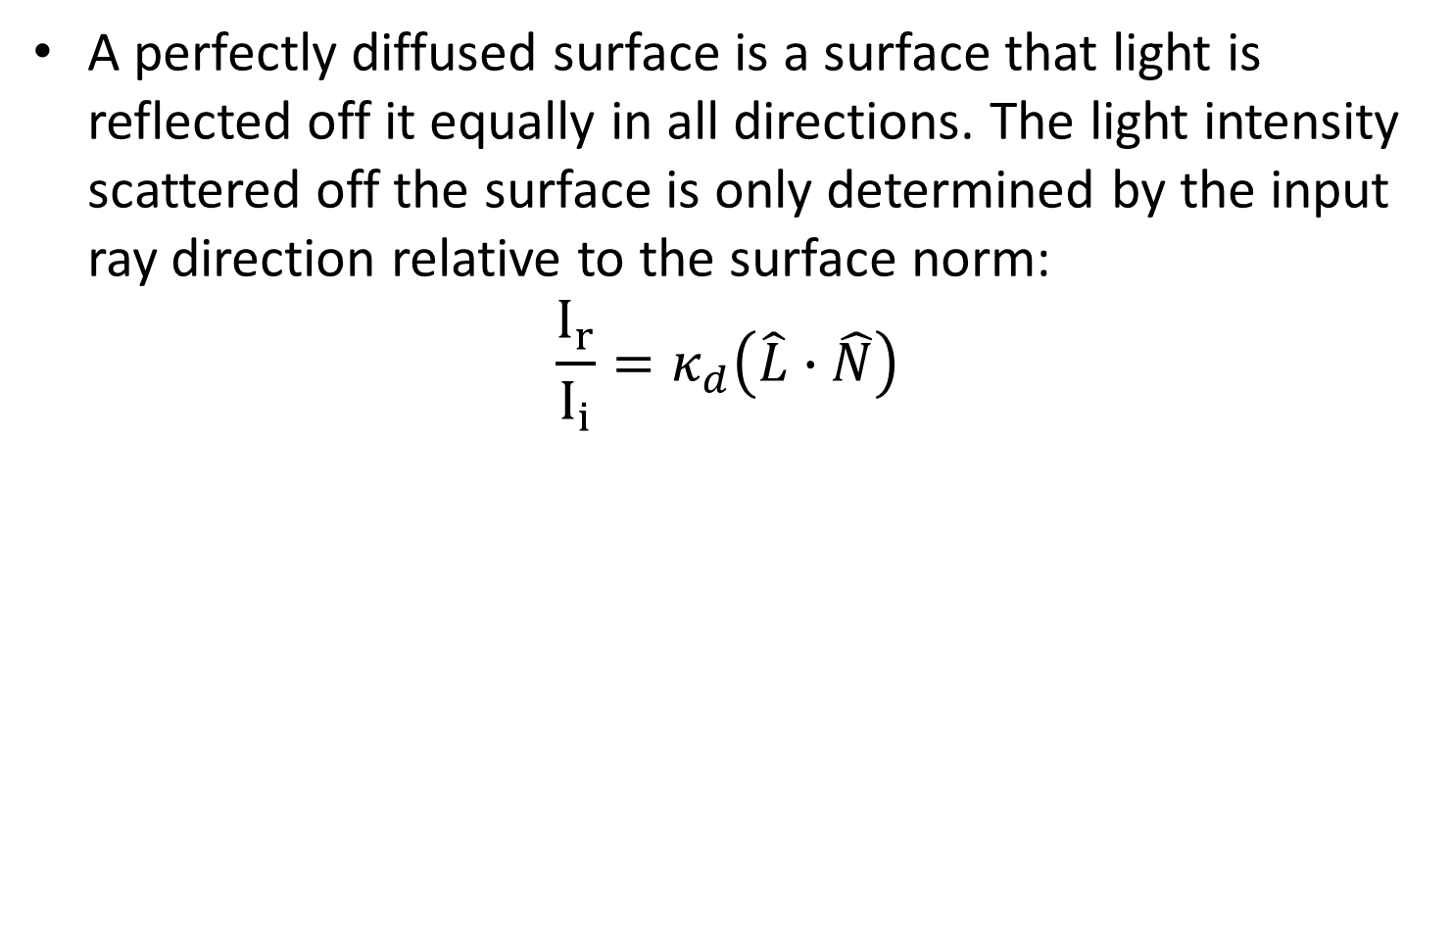
BRDF of a diffused surface
A perfectly diffused surface is a surface that light is reflected off it equally in all directions. The light intensity scattered off the surface is only determined by the input ray direction relative to the surface norm:
$$\frac{I_{r}}{I_{i}}=κ_{d}\left(\hat{L}∙\hat{N}\right)$$
Notes:
The returned angle doesn’t matter:
Eye(x,0,5)- change x
Center(0,0,0)
Light(-5,0,5)
The light on Z surface isn’t changing when changing angle of view.
Now change the lights’ x place and rerun the experiment.

Slide 10
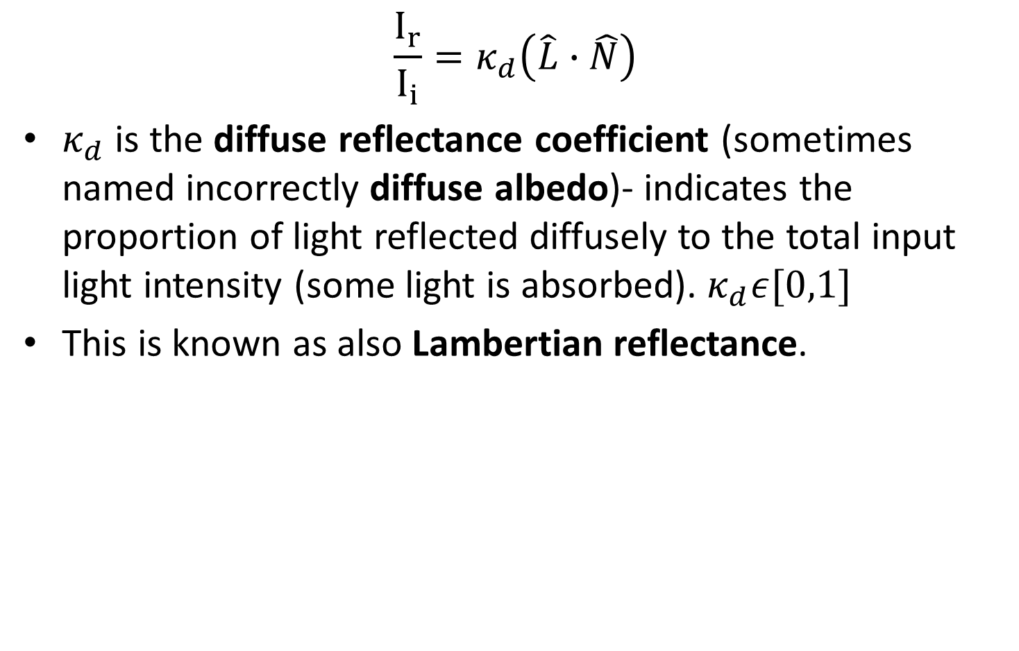
BRDF of a diffused surface
$$\frac{I_{r}}{I_{i}}=κ_{d}\left(\hat{L}∙\hat{N}\right)$$
$κ_{d}$ is the diffuse reflectance coefficient (sometimes named incorrectly diffuse albedo)- indicates the proportion of light reflected diffusely to the total input light intensity (some light is absorbed). $κ_{d}ε[0,1]$
This is known as also Lambertian reflectance.
Notes:
The returned angle doesn’t matter:
Eye(x,0,5)- change x
Center(0,0,0)
Light(-5,0,5)
The light on Z surface isn’t changing when changing angle of view.
Now change the lights’ x place and rerun the experiment.

Slide 11
BRDF of a diffused surface
Diffused surface demo: http://learnwebgl.brown37.net/09_lights/lights_diffuse.html

Slide 12
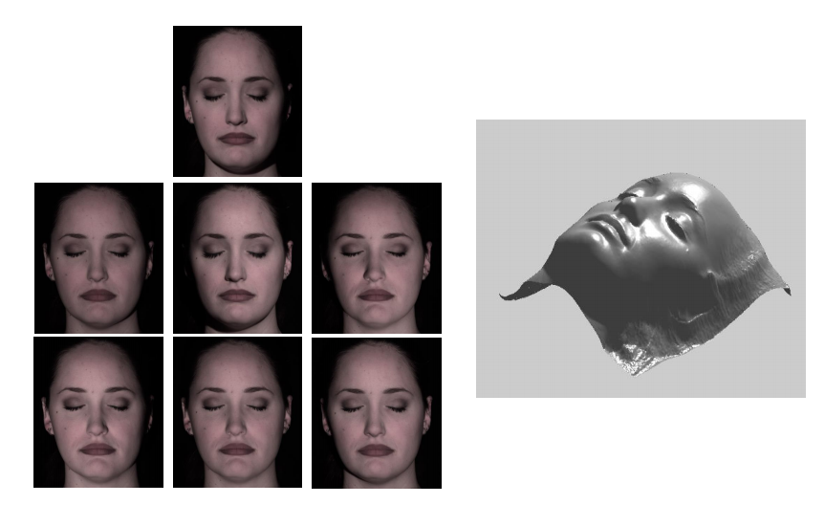

Side note: photometric stereo
Estimating surface normals from 2D images of different lighting conditions.
Assumes Lambertian surface.

Slide 13
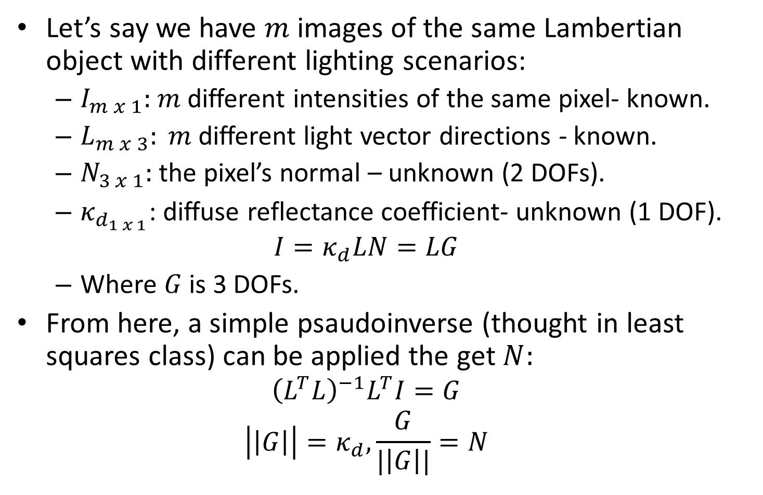
Side note: photometric stereo
Let’s say we have $m$ images of the same Lambertian object with different lighting scenarios:
$I_{m x 1}:$ $m$ different intensities of the same pixel- known.
$L_{m x 3}: m$ different light vector directions - known.
$N_{3 x 1}:$ the pixel’s normal – unknown (2 DOFs).
$κ_{d_{1 x 1}}$: diffuse reflectance coefficient- unknown (1 DOF).
$$I=κ_{d}LN=LG$$
Where $G$is 3 DOFs.
From here, a simple psaudoinverse (thought in least squares class) can be applied the get $N:$
$${\left(L^{T}L\right)}^{−1}L^{T}I=G$$
$$\left|\left|G\right|\right|=κ_{d},\frac{G}{|\left|G\right||}=N$$

Slide 14
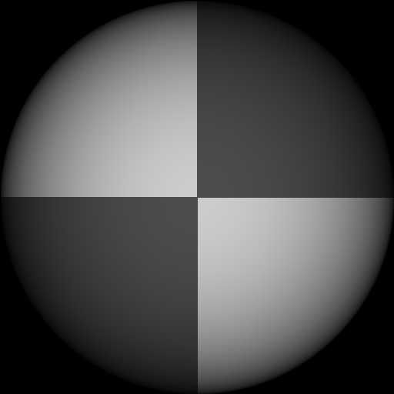
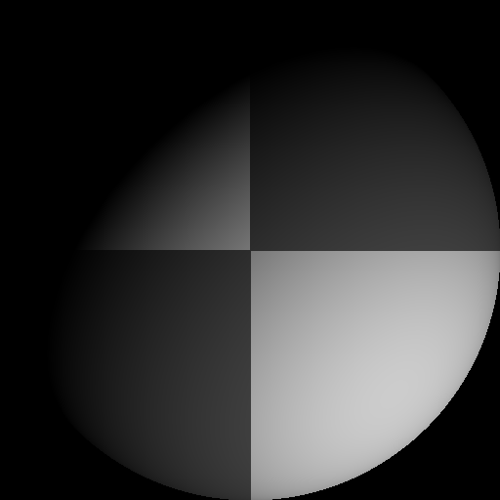
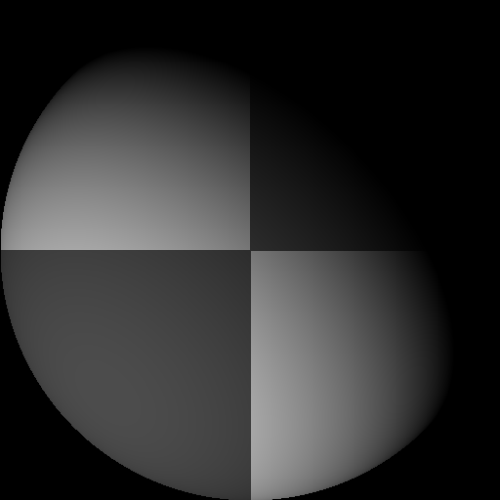
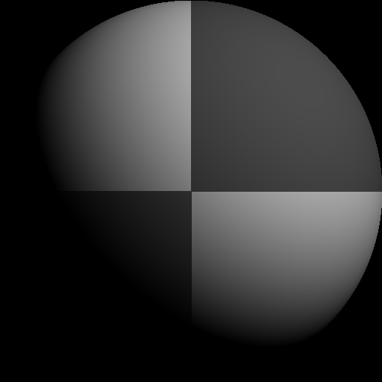
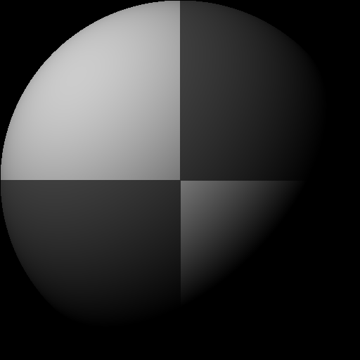
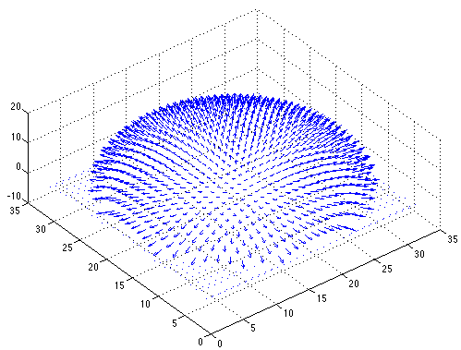

Side note: photometric stereo
Recovered albedo
Recovered normal field
Forsyth & Ponce, Sec. 5.4

Slide 15
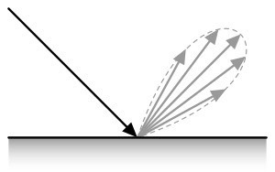
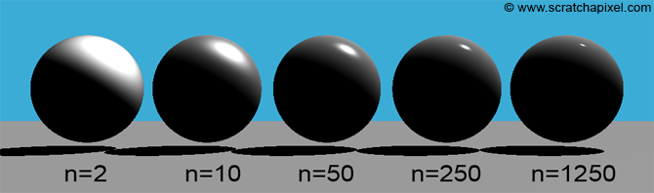
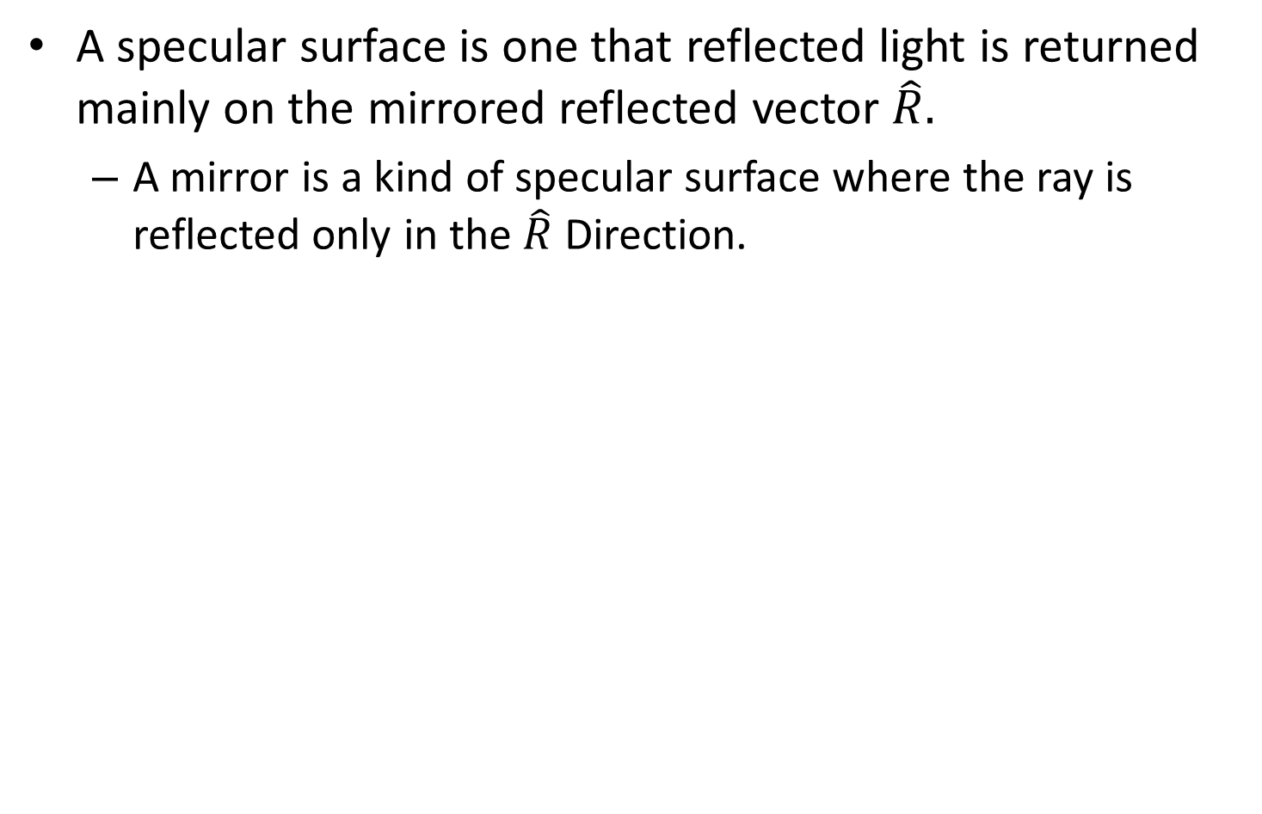
BRDF of a specular surface
A specular surface is one that reflected light is returned mainly on the mirrored reflected vector $\hat{R}.$
A mirror is a kind of specular surface where the ray is reflected only in the $\hat{R}$ Direction.

Slide 16

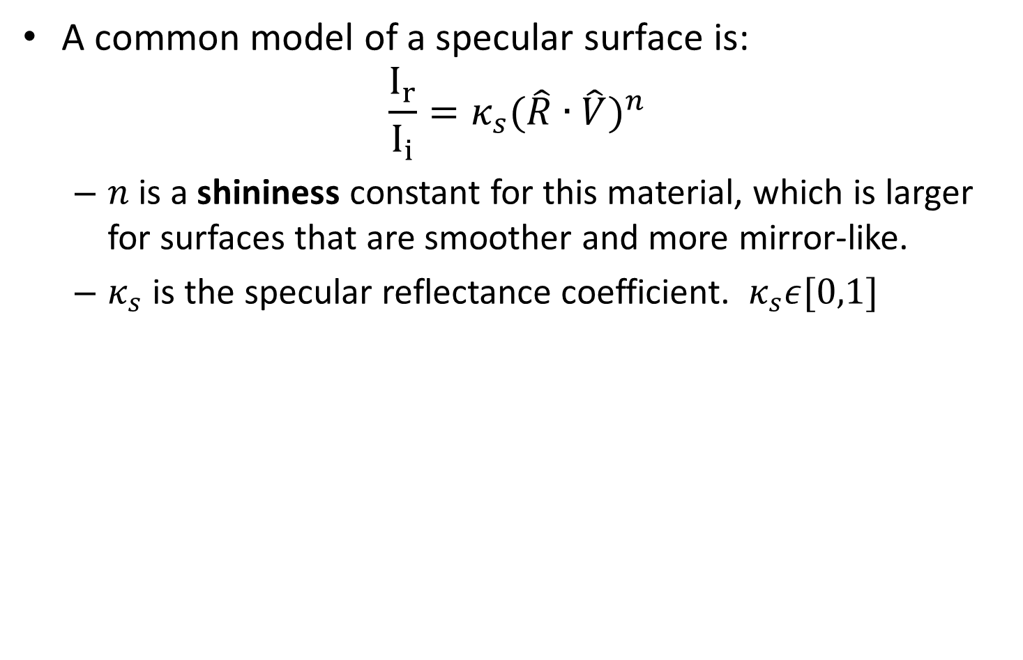
BRDF of a specular surface
A common model of a specular surface is:
$${\frac{I_{r}}{I_{i}}=κ_{s}(\hat{R}∙\hat{V})}^{n}$$
$n$ is a shininess constant for this material, which is larger for surfaces that are smoother and more mirror-like.
$κ_{s}$ is the specular reflectance coefficient. $κ_{s}ε[0,1]$

Slide 17
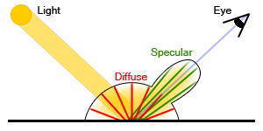
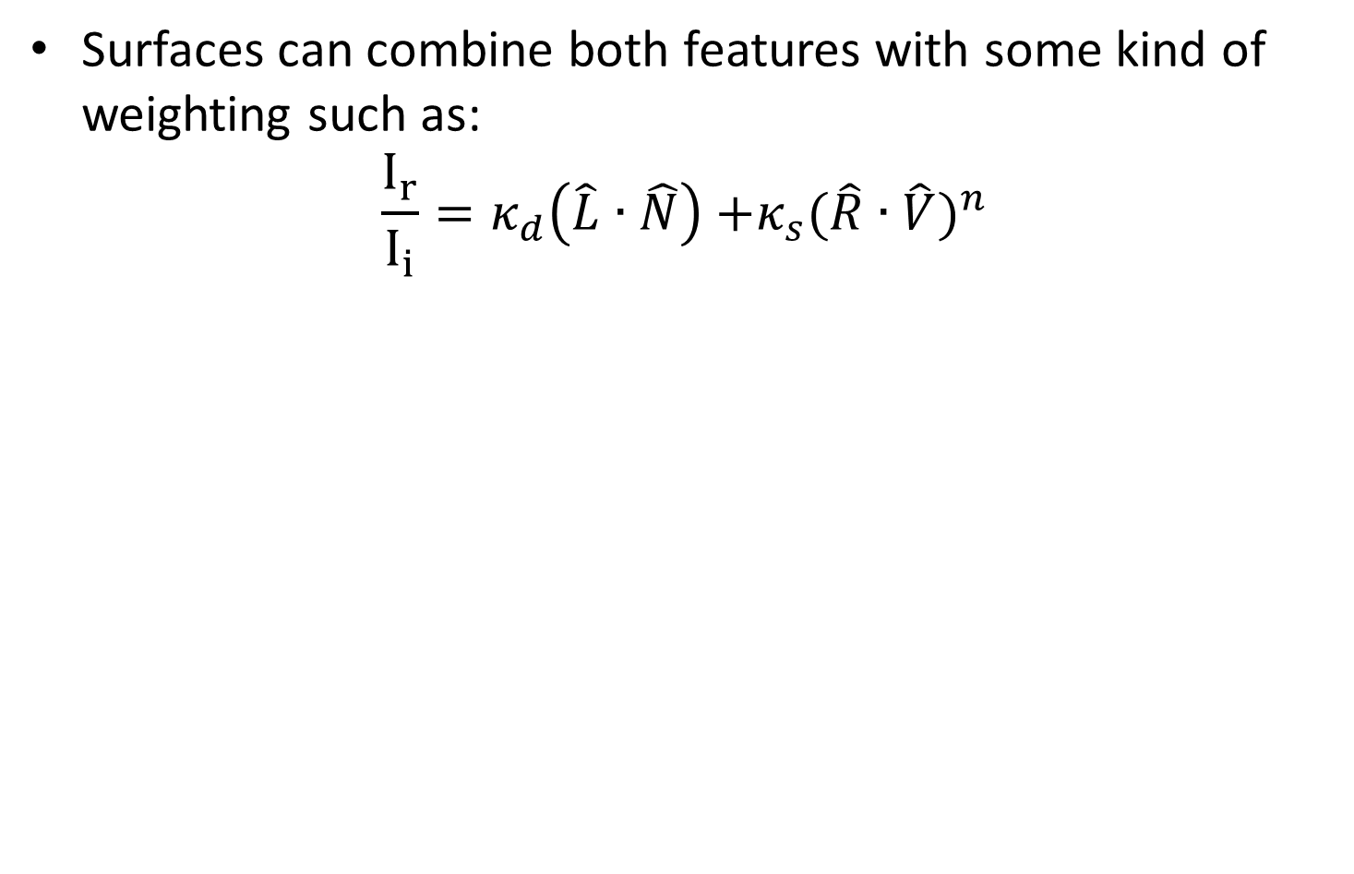
Diffused and specular surface
Surfaces can combine both features with some kind of weighting such as:
$$\frac{I_{r}}{I_{i}}=κ_{d}\left(\hat{L}∙\hat{N}\right){+κ_{s}(\hat{R}∙\hat{V})}^{n}$$

Slide 18
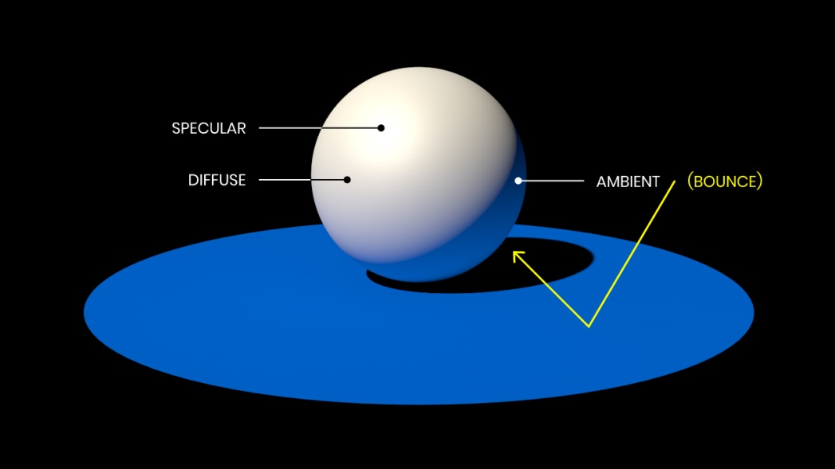
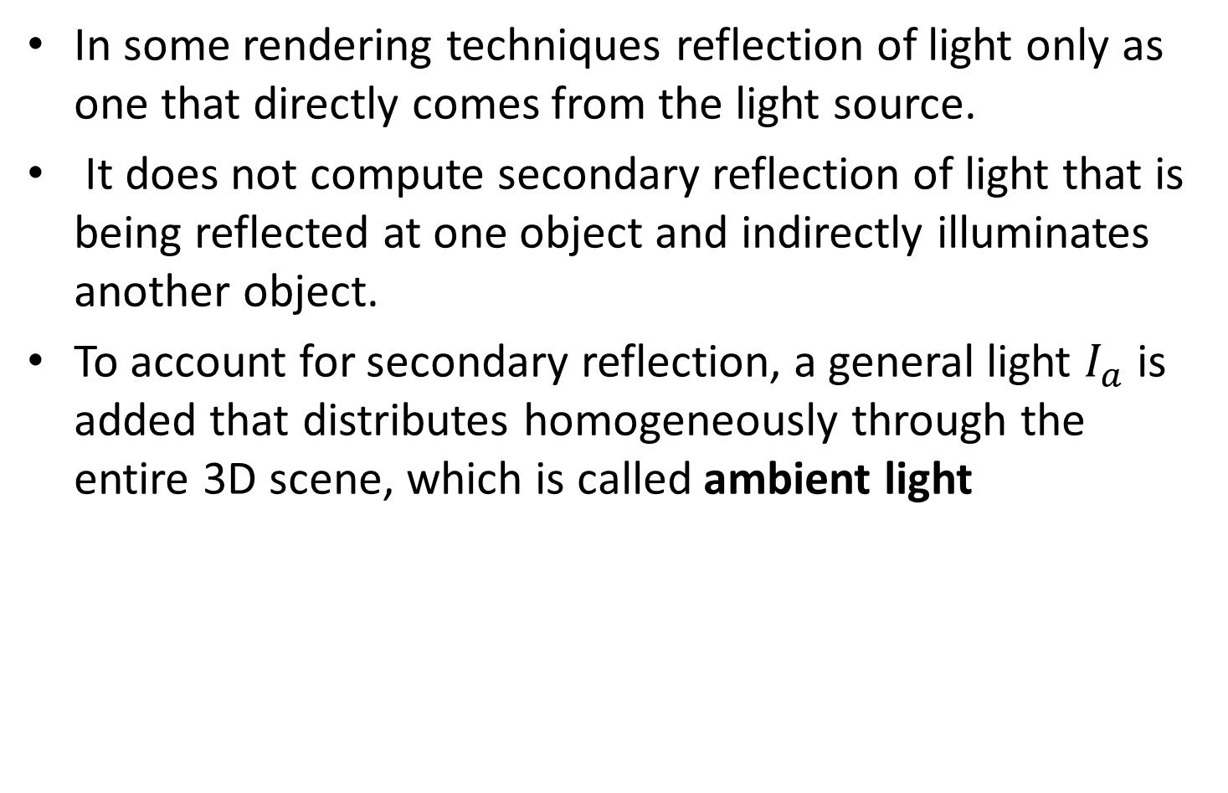
Ambient light
In some rendering techniques reflection of light only as one that directly comes from the light source.
It does not compute secondary reflection of light that is being reflected at one object and indirectly illuminates another object.
To account for secondary reflection, a general light $I_{a}$ is added that distributes homogeneously through the entire 3D scene, which is called ambient light

Slide 19
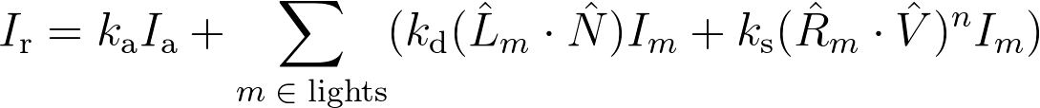
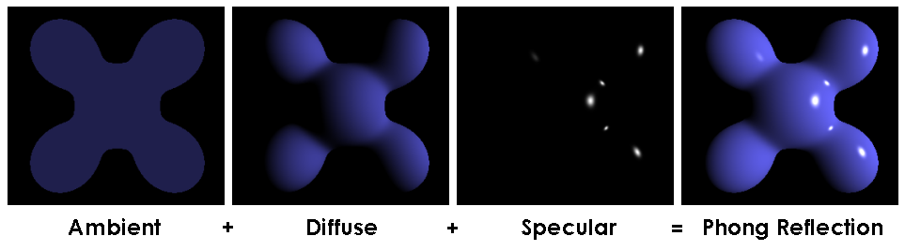
Phong reflection model
Bui Tuong Phong used ambient, diffused and specular reflections in a well known illumination model known as Phong reflection model:
Demo: http://www.cs.toronto.edu/~jacobson/phong-demo/
Notes:
I_\text{r} = k_\text{a} I_\text{a} + \sum_{m\;\in\;\text{lights}} (k_\text{d} (\hat{L}_m \cdot \hat{N}) I_{m} + k_\text{s} (\hat{R}_m \cdot \hat{V})^{n}I_{m})

Slide 20
Phong model limitations
Phong model doesn’t account for refraction and Interreflections.

Slide 21
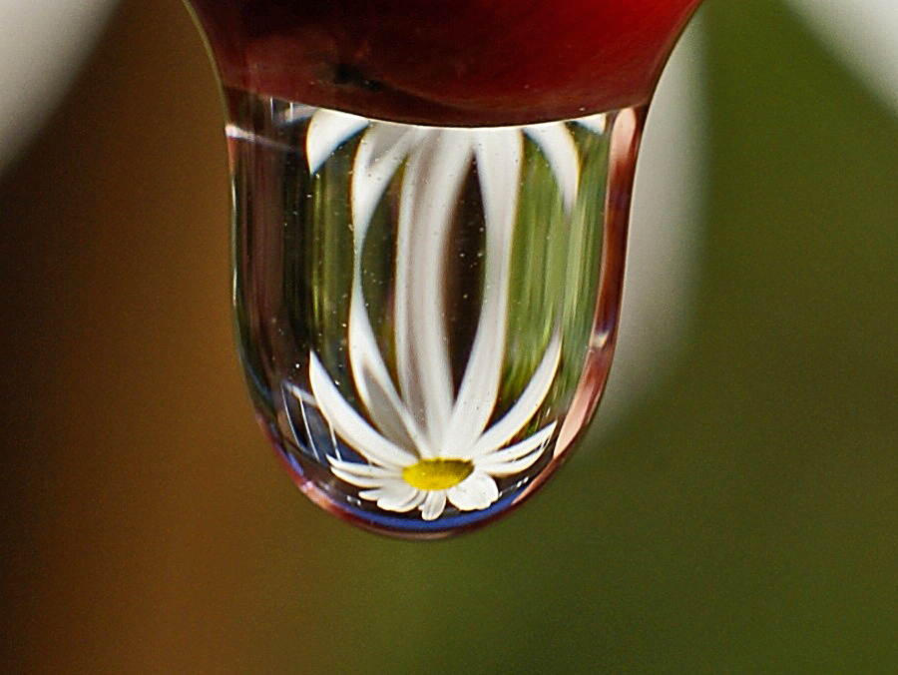
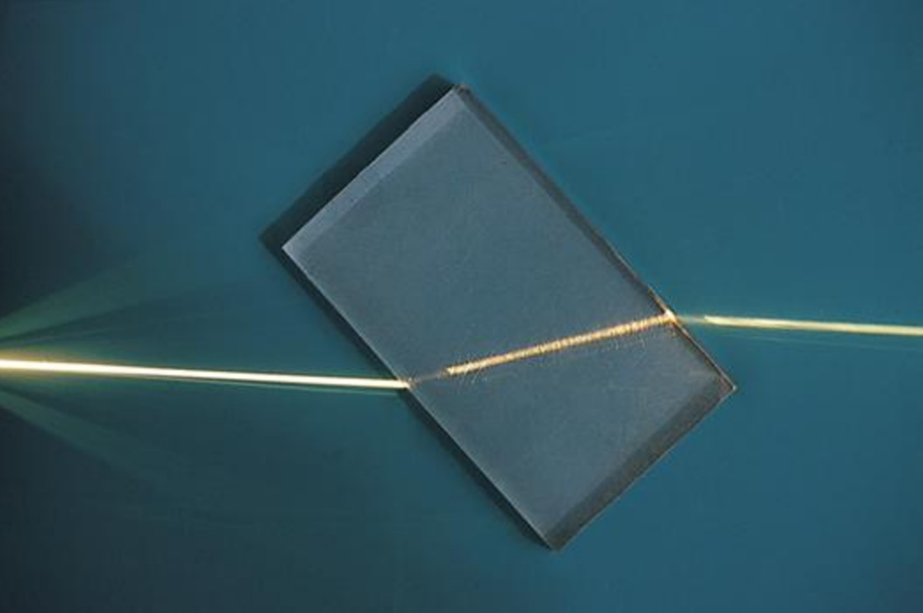
Phong model limitations
Refraction is the change in direction of a wave passing from one medium to another or from a gradual change in the medium.

Slide 22
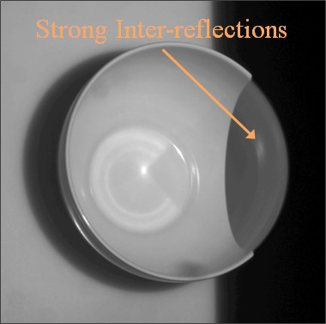
Phong model limitations
interreflection - reciprocal reflection between two reflecting surfaces

Slide 23
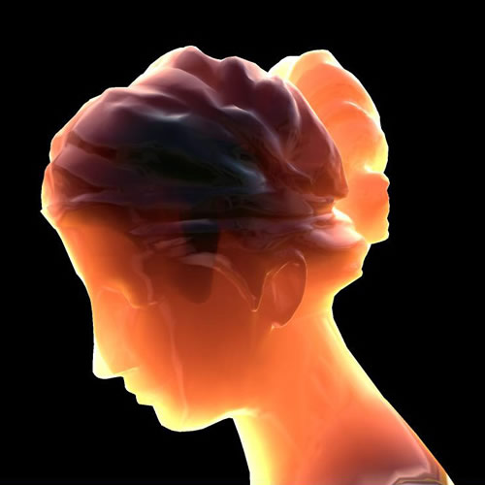
BRDF limitations
BRDF assumes single point of ray entering and single point for existing. It doesn't account for light rays that scatters through a medium
Subsurface scattering is a mechanism of light transport in which light that penetrates the surface of a translucent object, is scattered by interacting with the material, and exits the surface at a different point.

Slide 24
Contents
BRDF
Pinhole camera
Digital camera
The human eye
Image transformations

Slide 25
Pinhole imaging
What would an image taken like this look like?
barrier (diaphragm)
pinhole (aperture)
real-world object
digital sensor

Slide 26
Pinhole imaging
most rays are blocked
real-world object
digital sensor
one makes it through

Slide 27
Pinhole imaging
most rays are blocked
real-world object
digital sensor
one makes it through

Slide 28
Pinhole imaging
Each scene point contributes to only one sensor pixel.
real-world object
digital sensor

Slide 29
Pinhole imaging
Imaged object is inverted.
real-world object

Slide 30
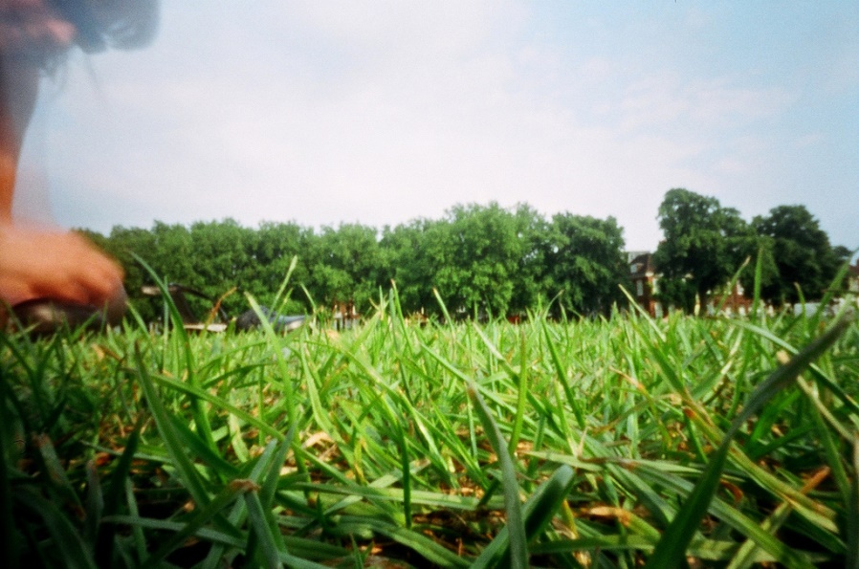
Blur in pinhole cameras
Since only one ray reaches every pixel in the pinhole camera, the image is always in focus.
(blur can come only from movement of camera or objects in time of exposure)

Slide 31
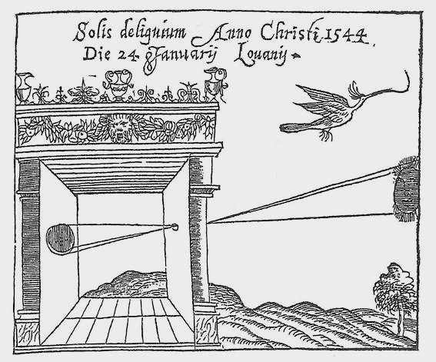
Pinhole camera a.k.a. camera obscura
Camera obscura - from Latin, meaning "dark room“.
First mention …
First camera …
Chinese philosopher Mozi
(470 to 390 BC)
Greek philosopher Aristotle
(384 to 322 BC)

Slide 32
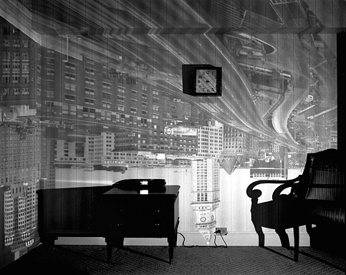
Examples of camera obscura

Slide 33
Examples of camera obscura

Slide 34
Sensor place
What happens as we change the place of the sensor?
real-world object

Slide 35
Sensor place
object projection is half the size
real-world object

Slide 36
Pinhole size
What happens as we change the pinhole diameter?
real-world object

Slide 37

Pinhole size
More light from different points of the object are integrated in the same pixel (integration->mean-> blur).
real-world object

Slide 38
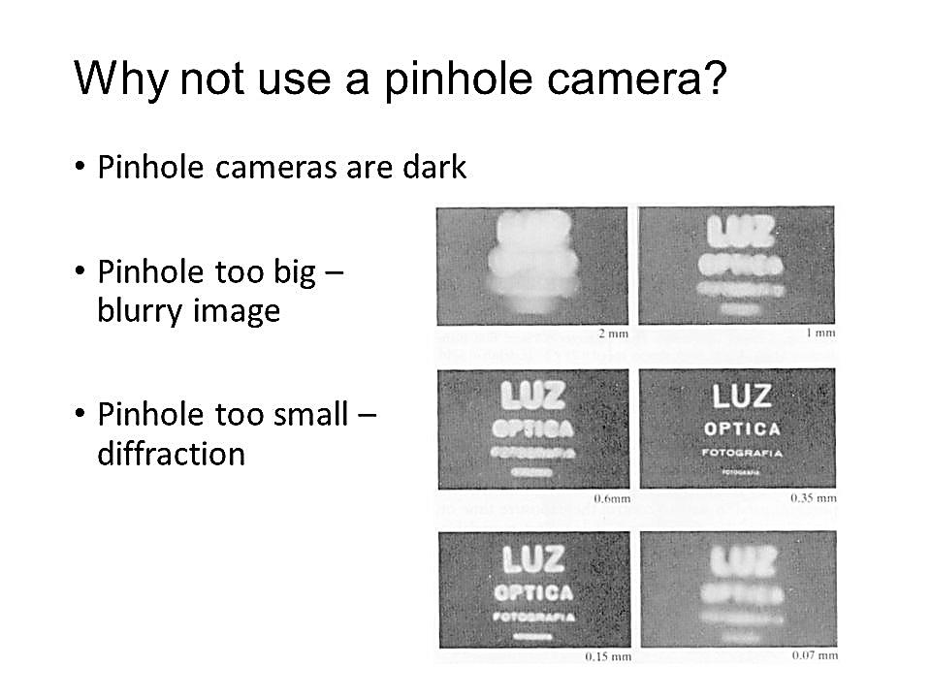
Side note: Pinhole size example
Is smaller pinhole means sharper image?

Slide 39
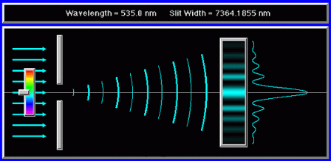
Side note: Pinhole size example
No! due to diffraction (Wave–particle duality of photons).

Slide 40
Contents
BRDF
Pinhole camera
Digital camera
The human eye
Image transformations

Slide 41
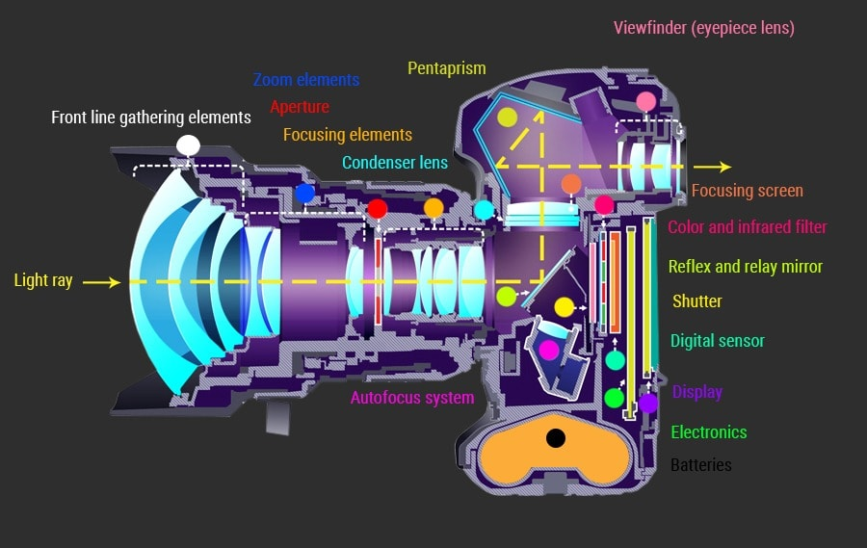
Digital single-lens reflex camera (DSLR)

Slide 42
Digital single-lens reflex camera (DSLR)

Slide 43
Pinhole to lens
All new cameras has lenses in them, what about it?

Slide 44
The lens camera
The lens can replace the pinhole, while giving the advantage of more input light.

Slide 45
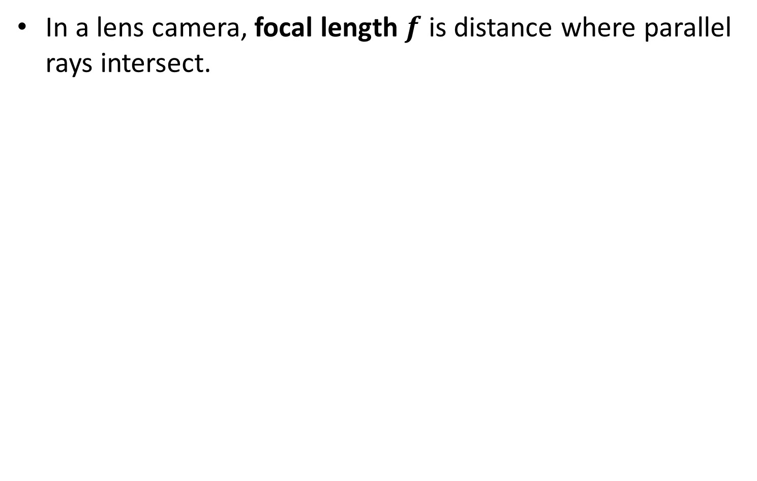

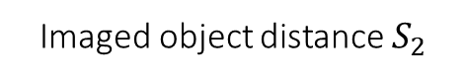

Focal length
In a lens camera, focal length$f$ is distance where parallel rays intersect.
object distance $S_{1}$
focal length $f$
Imaged object distance $S_{2}$

Slide 46
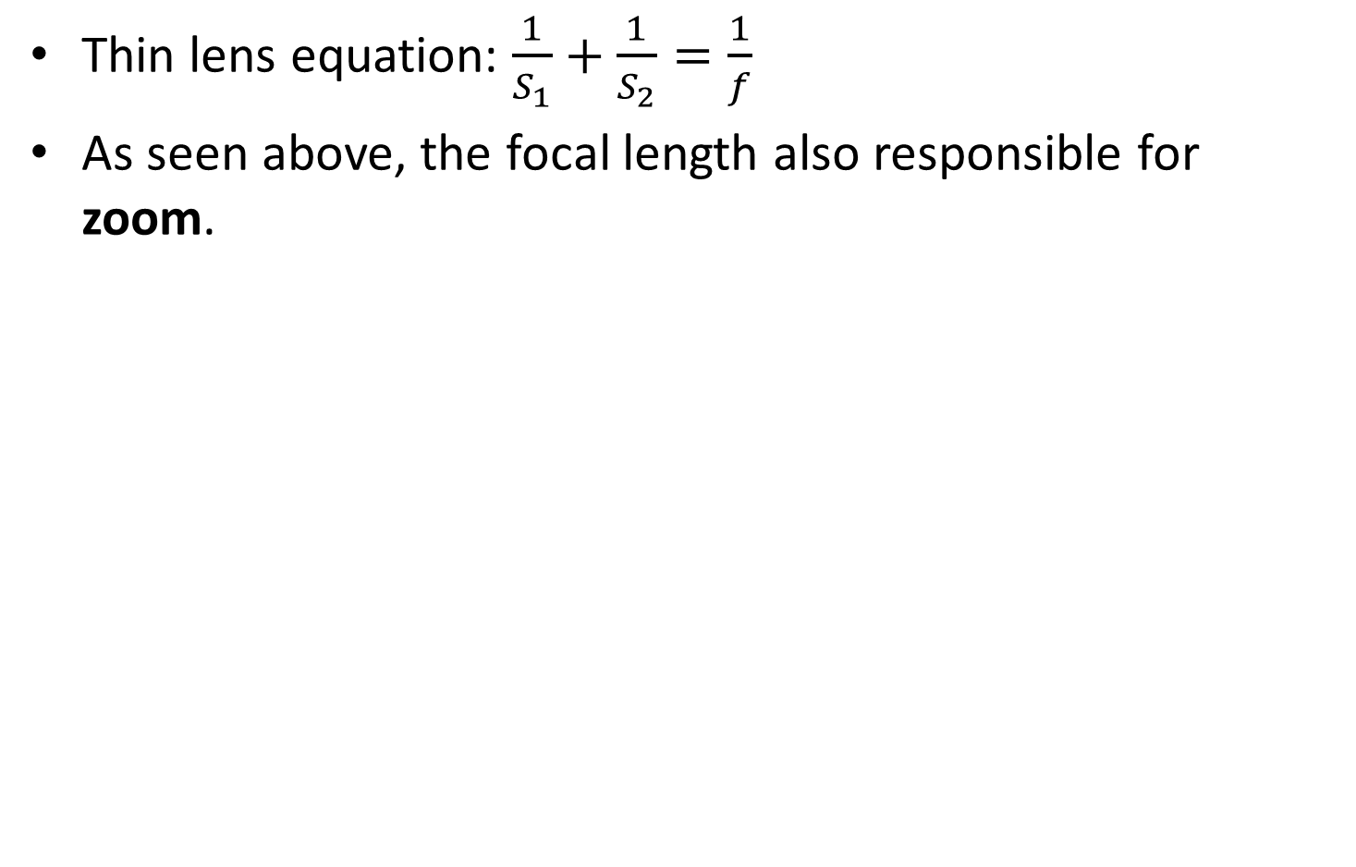
Focal length
Thin lens equation: $\frac{1}{S_{1}}+\frac{1}{S_{2}}=\frac{1}{f}$
As seen above, the focal length also responsible for zoom.
object distance $S_{1}$
focal length $f$
Imaged object distance $S_{2}$

Slide 47
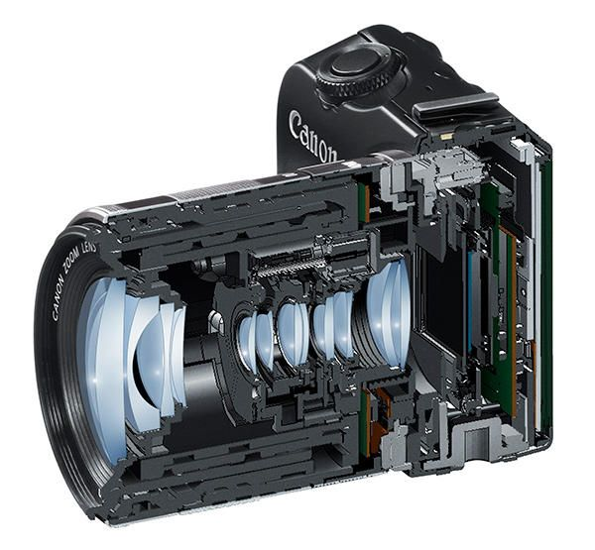
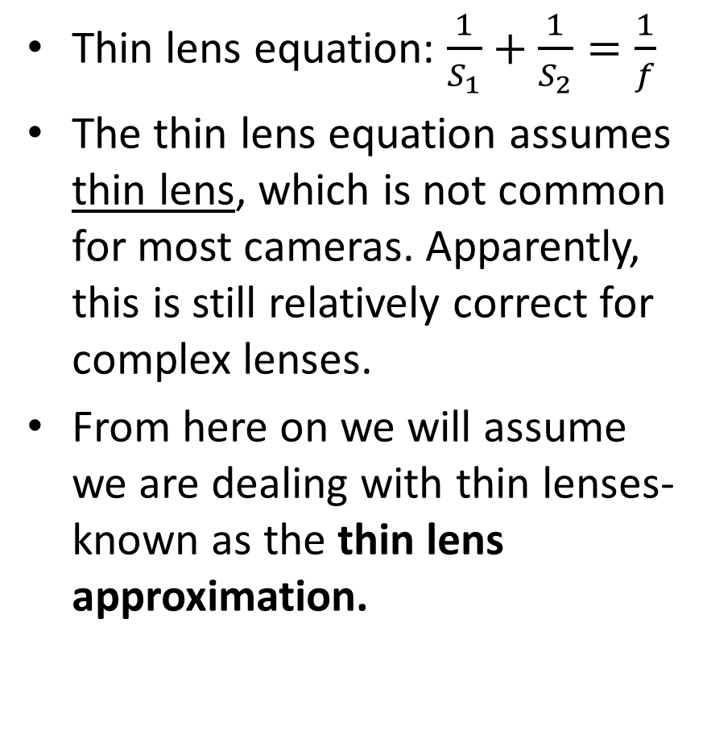
Side note: thin lens approximation
Thin lens equation: $\frac{1}{S_{1}}+\frac{1}{S_{2}}=\frac{1}{f}$
The thin lens equation assumes thin lens, which is not common for most cameras. Apparently, this is still relatively correct for complex lenses.
From here on we will assume we are dealing with thin lenses- known as the thin lens approximation.

Slide 48
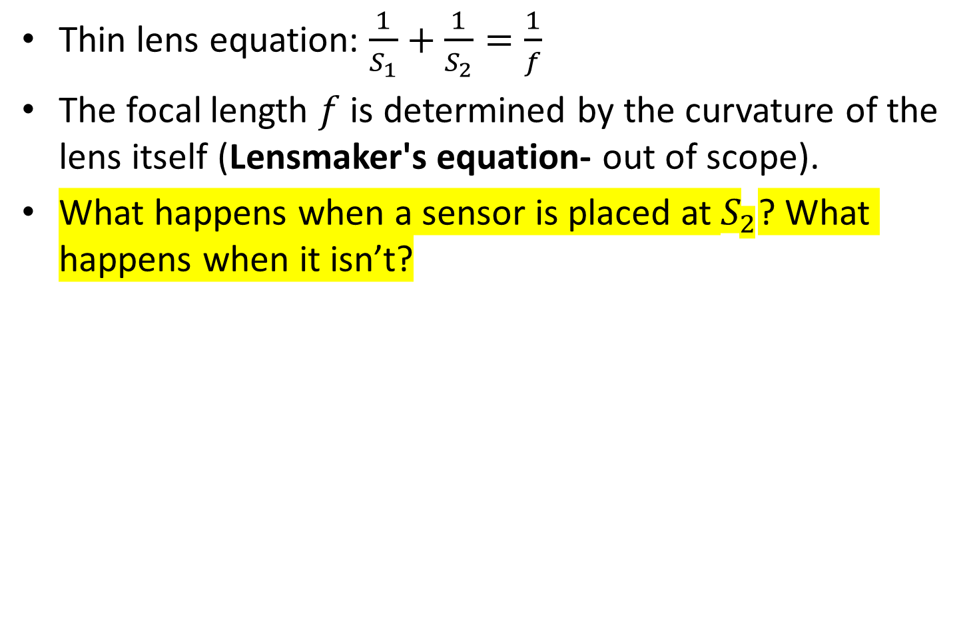
Focal length
Thin lens equation: $\frac{1}{S_{1}}+\frac{1}{S_{2}}=\frac{1}{f}$
The focal length $f$is determined by the curvature of the lens itself (Lensmaker's equation- out of scope).
What happens when a sensor is placed at $S_{2}$? What happens when it isn’t?

Slide 49
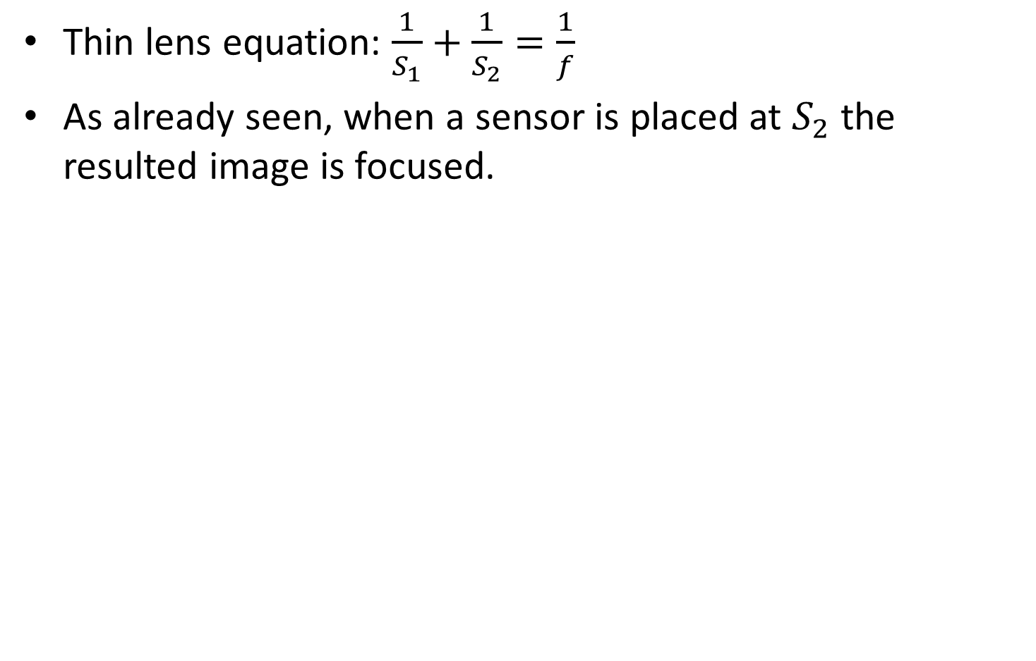



Focal length
Thin lens equation: $\frac{1}{S_{1}}+\frac{1}{S_{2}}=\frac{1}{f}$
As already seen, when a sensor is placed at $S_{2}$ the resulted image is focused.
object distance $S_{1}$
focal length $f$
Focused Imaged object distance $S_{2}$

Slide 50


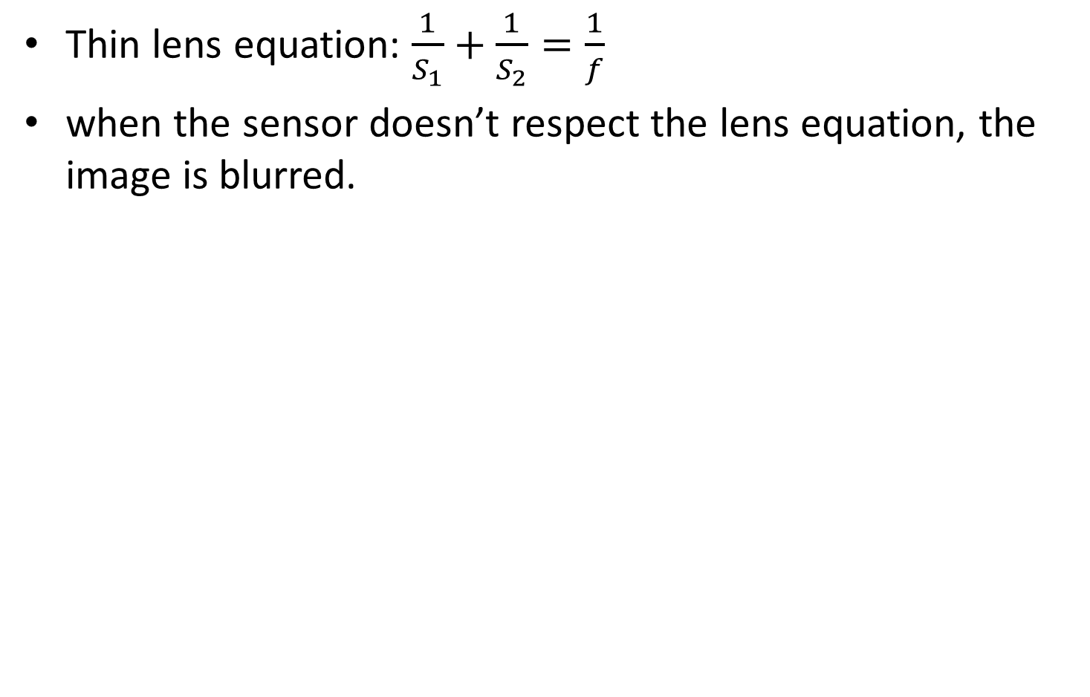


Focal length
Thin lens equation: $\frac{1}{S_{1}}+\frac{1}{S_{2}}=\frac{1}{f}$
when the sensor doesn’t respect the lens equation, the image is blurred.
object distance $S_{1}$
focal length $f$
Unfocused imaged object distance ${S′}_{2}$

Slide 51
Focus
Changing the distance between the sensor and a given lens to make the object more sharp.

Slide 52

Zoom
Changing the relation between lenses in complex lens setup effectively changes the focal length of the thin lens approximation and there by changing the size of the viewed object.
focal length $f$

Slide 53
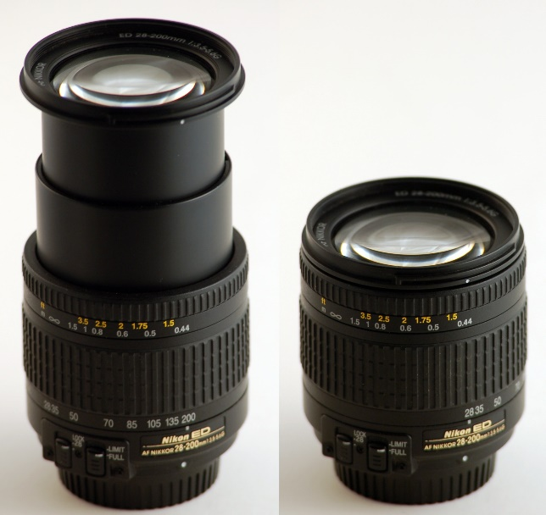
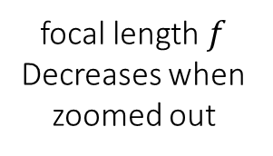
Zoom
Changing the relation between lenses in complex lens setup effectively changes the focal length of the thin lens approximation and there by changing the size of the viewed object.
focal length $f$
Decreases when zoomed out

Slide 54
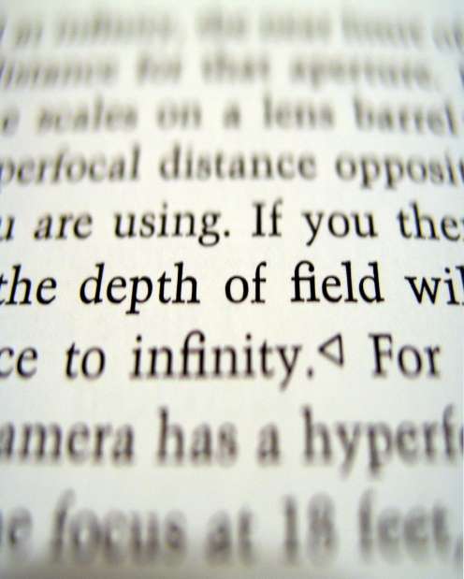

Depth of field (DOF)
Depth of field is the distance between the nearest and the farthest objects that are in acceptably sharp focus in an image.
“acceptably sharp” is human determined and is measured by the spot size that a point light is out of focus (called circle of confusion).

Slide 55
Digital single-lens reflex camera (DSLR)

Slide 56


Aperture
An aperture is a hole or an opening through which light travels. The aperture helps enlarging the DOF, but also inputs less light, making the image darker.

Slide 57


Side note: aperture blur
Changing the default shape of the aperture will give different shapes to “circle of confusion”.

Slide 58
Digital single-lens reflex camera (DSLR)

Slide 59

shutter
A common why to make the image lighter is to increase exposure time (also called “shutter speed”, although measurements units are seconds).
Larger exposure time can also lead to image blur if camera is not stable during capture
https://www.youtube.com/watch?v=ptfSW4eW25g (shutter and reflex mirror operation slow-mo)

Slide 60
Digital single-lens reflex camera (DSLR)

Slide 61

Photosensors
Sensor that transforms different input light intensity to different valued electrical charges.
Each pixel in resulting raw image comes from one capacitor in a 2D array which makes the sensor.
Two types of such sensors are called CCD (charge-coupled device) or CMOC (complementary metal-oxide-semiconductors).

Slide 62


Bayer filter
On top of each photosensor is a Bayer filter which filter the input light to one of the 3 primary colors R,G & B.
This filter has twice as much green elements compared to the others, to mimic the human eye physiology.

Slide 63
Contents
BRDF
Pinhole camera
Digital camera
The human eye
Image transformations

Slide 64

Human color perception
The modern camera tries to mimic the human eye:
Iris = aperture.
Lens.
Retina = photosensor.

Slide 65

Human color perception
In the retina there are two types of photoreceptors:
Rods: responsible for low-light vision – maximum sensitive in green region of 500nm. Rods are not responsible for color vision though.
Cones: responsible for color vision. 3 types (short, medium & long), each has maximum sensitive for different colors (roughly RGB…). this is way the RGB were chosen as primary colors.

Slide 66

Human color perception
The eye color sensitivity (Luminosity function) was defined by experiments- one result from this experiments is that green color is more sensitive than others.
This is way Bayer filter has double the greens!

Slide 67
Contents
BRDF
Pinhole camera
Digital camera
The human eye
Image transformations

Slide 68



objective
Being able to do all of the below transformations with matrix manipulation:
Why matrix manipulation?
translation
rotation
scale
shear
affine
projective

Slide 69
objective
Being able to do all of the below transformations with matrix manipulation:
Why matrix manipulation? Because then we can easily concatenate transformations (for example translation and rotation).
translation
rotation
scale
shear
affine
projective

Slide 70


2D planar transformations

Slide 71
scale
How?
Scale

Slide 72
scale
Scale

Slide 73

scale
matrix representation of scaling:
scaling matrix S
Scale

Slide 74
Shear
How?
Shear

Slide 75


Shear
or in matrix form:
Shear

Slide 76





Rotation
How?
rotation around the origin
$$r$$
$$r$$
$$φ$$

Slide 77
Rotation
Polar coordinates…
x = r cos (φ)
y = r sin (φ)
x’ = r cos (φ + θ)
y’ = r sin (φ + θ)
Trigonometric Identity…
x’ = r cos(φ) cos(θ) – r sin(φ) sin(θ)
y’ = r sin(φ) cos(θ) + r cos(φ) sin(θ)
Substitute…
x’ = x cos(θ) - y sin(θ)
y’ = x sin(θ) + y cos(θ)
rotation around the origin
$$r$$
$$r$$
$$φ$$

Slide 78


Rotation
or in matrix form:
rotation around the origin

Slide 79
Concatenation
How do we do concatenation of two or more transformations?
Notes:
\\
\begin{bmatrix}x'
\\ y'
\end{bmatrix}
=
\begin{bmatrix}a & 0
\\ 0 & b
\end{bmatrix}
\begin{bmatrix}x
\\ y
\end{bmatrix}
\textrm{and then}
\begin{bmatrix}x''
\\ y''
\end{bmatrix}
=
\begin{bmatrix}cos\theta & -sin\theta
\\ sin\theta & cos\theta
\end{bmatrix}
\begin{bmatrix}x'
\\ y'
\end{bmatrix}
\\
\\
\mapsto
\\
\\
\begin{bmatrix}x''
\\ y''
\end{bmatrix}
=
\begin{bmatrix}cos\theta & -sin\theta
\\ sin\theta & cos\theta
\end{bmatrix}
\begin{bmatrix}a & 0
\\ 0 & b
\end{bmatrix}
\begin{bmatrix}x
\\ y
\end{bmatrix}
=
\begin{bmatrix}acos\theta & -sin\theta
\\ sin\theta & bcos\theta
\end{bmatrix}
\begin{bmatrix}x
\\ y
\end{bmatrix}

Slide 80

Concatenation
How do we do concatenation of two or more transformations?
Easy with matrix multiplication!
Notes:
\\
\begin{bmatrix}x'
\\ y'
\end{bmatrix}
=
\begin{bmatrix}a & 0
\\ 0 & b
\end{bmatrix}
\begin{bmatrix}x
\\ y
\end{bmatrix}
\textrm{and then}
\begin{bmatrix}x''
\\ y''
\end{bmatrix}
=
\begin{bmatrix}cos\theta & -sin\theta
\\ sin\theta & cos\theta
\end{bmatrix}
\begin{bmatrix}x'
\\ y'
\end{bmatrix}
\\
\\
\mapsto
\\
\\
\begin{bmatrix}x''
\\ y''
\end{bmatrix}
=
\begin{bmatrix}cos\theta & -sin\theta
\\ sin\theta & cos\theta
\end{bmatrix}
\begin{bmatrix}a & 0
\\ 0 & b
\end{bmatrix}
\begin{bmatrix}x
\\ y
\end{bmatrix}
=
\begin{bmatrix}acos\theta & -bsin\theta
\\ asin\theta & bcos\theta
\end{bmatrix}
\begin{bmatrix}x
\\ y
\end{bmatrix}

Slide 81
Translation
How?

Slide 82


Translation
What about matrix representation?

Slide 83
Translation
What about matrix representation?
Not possible.

Slide 84

Homogeneous coordinates
Homogeneous coordinates represent 2D point with a 3D vector.
heterogeneous coordinates
homogeneous coordinates
$$\left[\begin{matrix}x \\ y\end{matrix}\right]→\left[\begin{matrix}x \\ y \\ 1\end{matrix}\right]$$

Slide 85

Homogeneous coordinates
Homogeneous coordinates represent 2D point with a 3D vector:
Homogeneous coordinates are only defined up to scale.
heterogeneous coordinates
homogeneous coordinates
$\left[\begin{matrix}x \\ y\end{matrix}\right]→\left[\begin{matrix}x \\ y \\ 1\end{matrix}\right]$ $≝\left[\begin{matrix}ax \\ ay \\ a\end{matrix}\right]$

Slide 86
Translation
How do we do it now?

Slide 87

Translation
Notes:
\\
\begin{bmatrix}x'
\\ y'
\\1
\end{bmatrix}
=
\begin{bmatrix}1 & 0 & t_x
\\ 0 & 1 & t_y
\\ 0 & 0 & 1
\end{bmatrix}
\begin{bmatrix}x
\\ y
\\1
\end{bmatrix}

Slide 88

Side note: linear transformation
Linear transformation are Transformation that meets additively and scalar multiplication conditions:
Translation is not a linear transformation since it doesn’t meet the scalar multiplication condition.
Properties of linear transformations:
Origin maps to origin
Lines map to lines
Parallel lines remain parallel
Ratios are preserved

Slide 89

Affine Transformations
Affine transformations are combinations of linear transformations and translations
Properties of affine transformations:
Origin maps to origin
Lines map to lines
Parallel lines remain parallel
Ratios are preserved
Notes:
\\
\begin{bmatrix}x'
\\ y'
\\w
\end{bmatrix}
=
\begin{bmatrix}a & b&c
\\ d & e&f
\\0&0&1
\end{bmatrix}
\begin{bmatrix}x
\\ y
\\w
\end{bmatrix}
\mathrm{\mathbf{or}}
\begin{bmatrix}x'
\\ y'
\end{bmatrix}
=
\begin{bmatrix}a & b
\\ d & e
\end{bmatrix}
\begin{bmatrix}x
\\ y
\end{bmatrix}
+
\begin{bmatrix}c
\\ f
\end{bmatrix}

Slide 90


Affine transformation: example
Translate then scale vs. scale then translate :
Order of matrices DOES matter ($A∙B≠B∙A)$
Notes:
\\
\begin{bmatrix}x'
\\ y'
\\w
\end{bmatrix}
=
\begin{bmatrix}a & 0&0
\\ 0 & b&0
\\0&0&1
\end{bmatrix}
\begin{bmatrix}1 & 0&t_x
\\ 0 & 1&t_y
\\0&0&1
\end{bmatrix}
\begin{bmatrix}x
\\ y
\\w
\end{bmatrix}
=
\begin{bmatrix}a & 0 &at_x
\\ 0 & b & bt_y
\\0&0&1
\end{bmatrix}
\begin{bmatrix}x
\\ y
\\w
\end{bmatrix}
\\\\
\neq
\\\\
\begin{bmatrix}x''
\\ y''
\\w
\end{bmatrix}
=
\begin{bmatrix}1 & 0&t_x
\\ 0 & 1&t_y
\\0&0&1
\end{bmatrix}
\begin{bmatrix}a & 0&0
\\ 0 & b&0
\\0&0&1
\end{bmatrix}
\begin{bmatrix}x
\\ y
\\w
\end{bmatrix}
=
\begin{bmatrix}a & 0 &t_x
\\ 0 & b & t_y
\\0&0&1
\end{bmatrix}
\begin{bmatrix}x
\\ y
\\w
\end{bmatrix}

Slide 91

Projective transformation
Also known as homography or homographic transformation.
A generalization of affine transformation.
Properties of projective transformations:
Origin maps to origin
Lines map to lines
Parallel lines remain parallel
Ratios are preserved

Slide 92
Projective transformation
How many DOFs do we have here?

Slide 93
Projective transformation
How many DOFs do we have here?
8, since it is true up to scale (homogenous coordinates)

